Slide 1
Web Integrated IoT Based Automated Irrigation And Controlling System
Group Members:
Amey Rajul Shamkuwar- IEC2017084
Rakesh Kumar- IEC2017032
Pradumna Shivanand Tamkute- IEC2017059
Semester - V
Project Mentor :- Dr. Sanjai Singh
Assistant Professor
Department of Electronics and Communication Engg

Slide 2
Introduction
Agriculture sector is the backbone of Indian economy with a whopping share of 15.87%.
This sector is getting some major setbacks in recent times due to various factors.
One of the primary reasons for this is the rising surplus of the electricity charges for irrigating the crops at timely manner.
Water crisis is major concern for the mankind at present.
With the advent of IoT technology farming can see major upsurge in its production along with becoming major profitable sector by cutting cost on various extra resources being wasted in due to human negligence.

Slide 3
Objective
Conservation of water and electricity
Automation of irrigation system.
Accessibility of farm system through web from anywhere
To provide optimum water irrigation to crops
Developing web based and mobile based app to control the system

Slide 4
Working principle
This model utilises the ability of Raspberry pi, which a microcontroller, to compute various conditions for the irrigation
The input to the Raspberry pi system is from three sensors namely – Soil Moisture Sensor, Temperature and Humidity sensor and Ultrasonic Sensor.
Soil moisture sensor works on the principle of resistance change in the soil and gives output for moisture content of the soil. Temperature and Humidity sensor works on the principle of temperature variation of resistance. Ultrasonic sensor measures the distance between objects and works on principle of reflection of Ultrasonic waves and speed of the waves.
The model works in real time and it gets reading of moisture contents of the soil and checks with a threshold value based on the crop which is being taken in the form. If the moisture is low then watering is done. Also the temperature is check so that on very hot day extra water can be provided in order to ensure that plants get enough water considering the evaporation of water due to heat. Ultrasonic sensor checks the water level in the tank to ensure proper water level is always maintained for the proper irrigation of fields.

Slide 5
Tools Used :-
Hardware
Raspberry Pi 3 Model
Soil Moisture Sensor
Temperature Sensor
Relay
HC-SR04 Ultrasonic Sensor
Software :-
Flask
Python modules
HTML
Adafruit

Slide 6
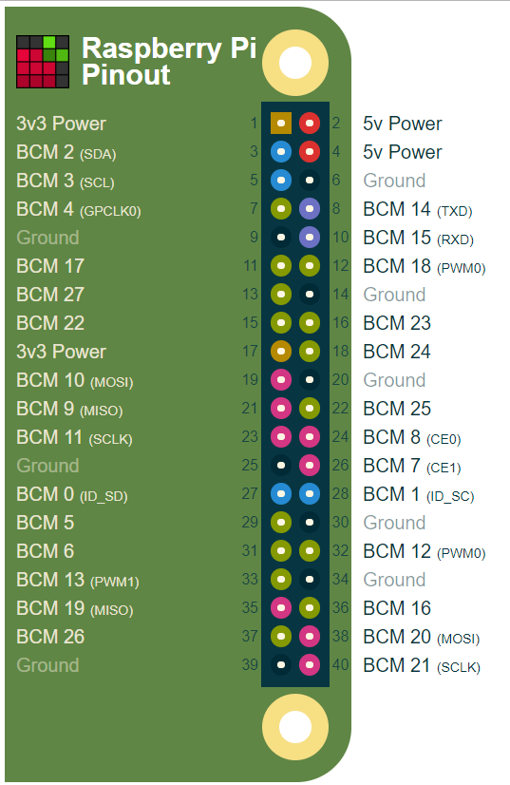
Pin diagram of Raspberry pi

Slide 7
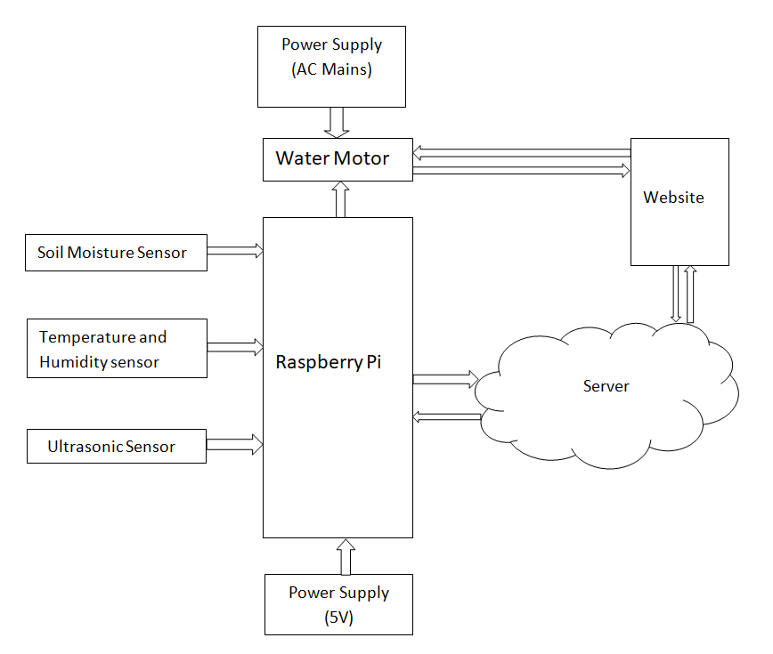
Proposed System

Slide 9
THANK YOU!

